Slide 1
Chapter 17: Making Complex decisions
These slides are adopted from Berkeley course materials and Russell and Norvig textbook

Slide 2
Sequential Decisions
In this chapter, we consider sequential decision problems, in which the agent’s utility depends on a sequence of decisions.
We focus on stochastic environments.

Slide 3
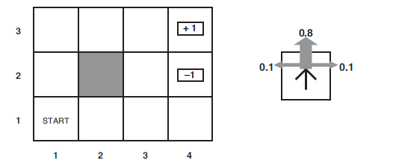
Example: Grid World
The agent lives in a 4x3 grid.
Walls block the agent’s path
The actions in every state ACTIONS(s): Up, Down, Left, and Right.
We assume a fully observable environment (the agent knows where
it is.
However, actions are noisy (stochastic environment).
Each action achieves the intended effect with probability 0.8,
but the rest of the time, the action moves the agent at right angles to the intended direction.
If the agent bumps into a wall, it stays in the same square.
For example:
80% of the time, the action Up takes the agent North (if there is no wall there)
10% of the time, North takes the agent West; 10% East

Slide 4
Example: Grid World
The transition model P(s’|s,a)
P(s’| s, a) to denote the probability of reaching state s’ if action a is done in state s.
We will assume that transitions are Markovian.
The probability of reaching s’ from s depends only on s and not on the history of earlier states.
The agent receives rewards R(s) each time step
Small “living” reward each step (can be positive or negative)
In the grid world example, R(s)=-0.04
Big rewards come at the end (good or bad)
For example:
In the grid world example, there are two terminal states having rewards +1 and –1.
All other states have a reward of –0.04.
Goal: maximize sum of rewards

Slide 5
Example: Grid World
If the environment were deterministic, a solution would be easy: [Up, Up, Right, Right,
Right].
Unfortunately, the environment won’t always go along with this solution, because the
actions are unreliable!

Slide 6
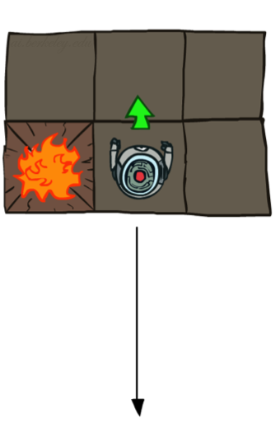
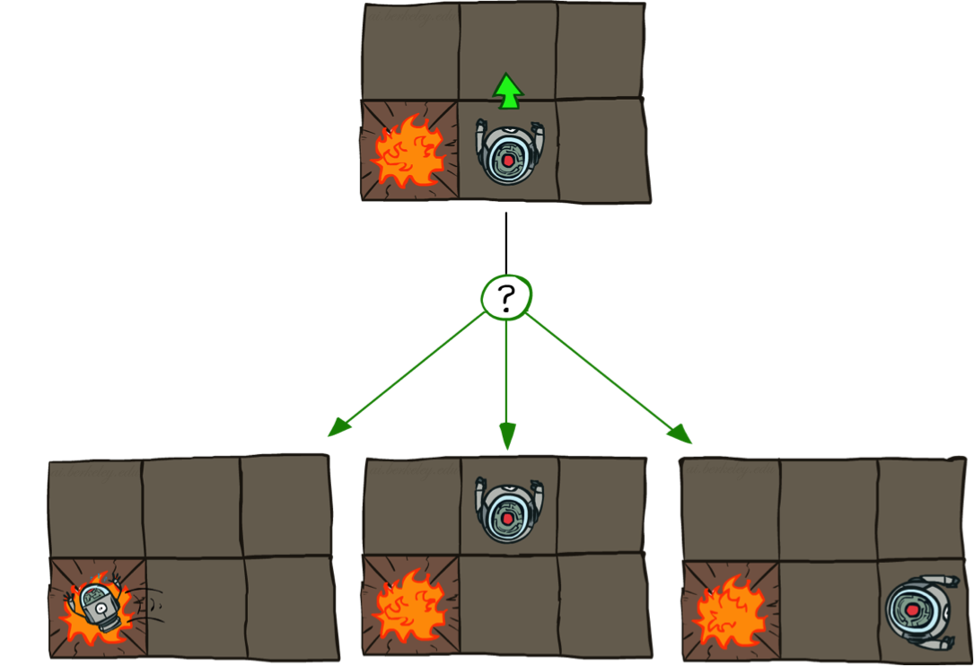
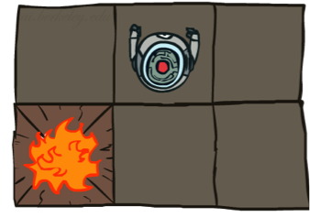
Grid World Actions
Stochastic Grid World
Deterministic Grid World
Notes:
When you plan you will have to take these into account

Slide 7
Markov Decision Processes (MDPs)
A sequential decision problem for a fully observable, stochastic environment
with a Markovian transition model and additive rewards is called a Markov decision process (MDP).

Slide 8

What is Markov about MDPs?
“Markov” generally means that given the present state, the future and the past are independent
For Markov decision processes, “Markov” means action outcomes depend only on the current state
This is just like search, where the successor function could only depend on the current state (not the history)
Notes:
Like search: successor function only depended on current state
Can make this happen by stuffing more into the state;
Very similar to search problems: when solving a maze with food pellets, we stored which food pellets were eaten!

Slide 9
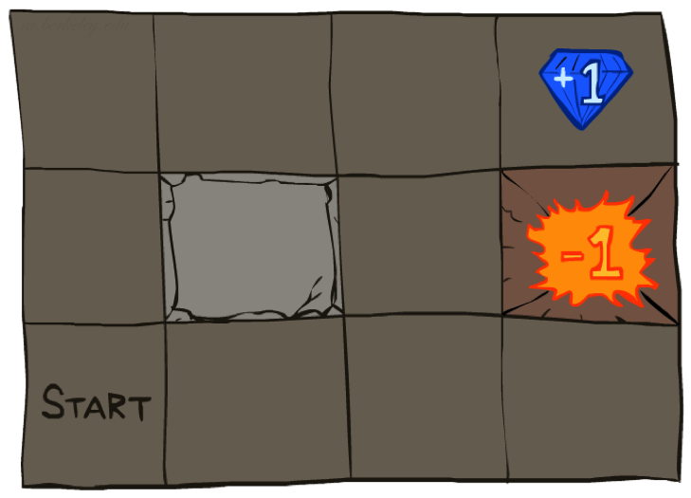




Markov Decision Processes (MDPs)
An MDP is defined by:
A set of states s ∈ S
A set of actions a ∈ A
A transition model T(s, a, s’)
Probability that a from s leads to s’, i.e., P(s’| s, a)
Also called the model or the dynamics
A reward function R(s, a, s’)
Sometimes just R(s)
An initial state S0
Maybe a terminal state
[Demo – gridworld manual intro (L8D1)]
Notes:
In search problems: did not talk about actions, but about successor functions --- now the information inside the successor function is unpacked into actions, transitions and reward
Write out S, A, example entry in T, entry in R; note: T has to some up to 1 over all s’s
Reward function different from the book : R(s,a,s’)
In book simpler for equations, but not useful for the projects.
Need to modify expectimax a tiny little bit to account for rewards along the way, but that’s something you should be able to do, and so you can already solve MDP’s (not in most efficient way)

Slide 10
Policy
In deterministic search problems, we wanted an optimal plan, or sequence of actions, from start to a goal.
What does a solution to a sequential decision problem look like?
Any fixed action sequence won’t solve the problem, because the agent might end up in a state
other than the goal.
Therefore, a solution must specify what the agent should do for any state that the agent might reach.
A solution of this kind is called a policy.

Slide 11
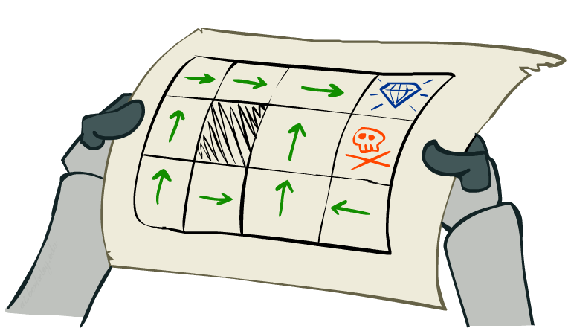
Policy
In deterministic search problems, we wanted an optimal plan, or sequence of actions, from start state to a goal.
For MDPs, we want an optimal
policy π*: S → A
A policy π gives an action for each state
An optimal policy is a policy that yields the maximum expected utility.
A policy represents the agent function explicitly and is therefore a description of a simple reflex agent, computed from the information used for a utility-based agent.
Optimal policy when R(s, a, s’) = -0.03 for all non-terminals s

Slide 12
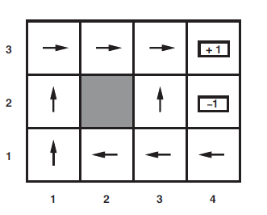
Optimal Policies
Since the cost of taking a step is fairly small compared with the penalty for ending up in (4,2) by accident, the optimal policy for the state (3,1) is conservative.
The policy recommends taking the long way round, rather than taking the shortcut and thereby risking entering (4,2).
R(s)=-0.04

Slide 13
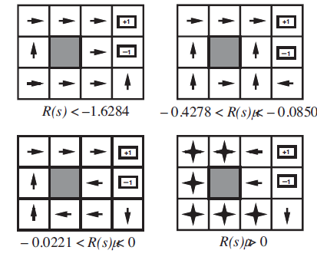
Optimal Policies
The balance of risk and reward changes depending on the value of R(s) for the nonterminal states.
For R(s) ≤ −1.6284, life is so painful that the agent heads
straight for the nearest exit, even if the exit is worth –1.
When −0.4278 ≤ R(s) ≤ −0.0850, life is quite unpleasant;
the agent takes the shortest route to the +1 state and is
willing to risk falling into the –1 state by accident.
For (−0.0221 < R(s) < 0), the optimal policy takes no risks
at all.
Finally, if R(s) > 0, then life is positively enjoyable and the
agent avoids both exits and the agent obtains infinite total reward
because it never enters a terminal state.

Slide 14
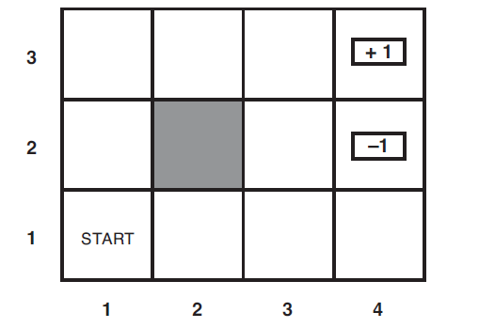
Finite vs. Infinite Horizons
Finite horizon means that there is a fixed time N after which nothing
matters (the game is over).
It is similar to depth-limited search.
For example, suppose an agent starts at (3,1), and N =3.
The optimal action is to go Up.
On the other hand, if N =100, then there is plenty of time to take the safe route.
The optimal action is to go Left.

Slide 15
Finite vs. Infinite Horizons
If the optimal action in a given state could change over time, the policy is named nonstationary.
Thus, finite horizons yield nonstationary policies.
With no fixed time limit, there is no reason to behave differently in the same state at different times. Hence, the optimal action depends only on the current state, and the optimal policy is stationary.
Infinite horizon does not necessarily mean that all state sequences are infinite; it just means that there is no fixed deadline.
In particular, there can be finite state sequences in an infinite-horizon MDP containing a terminal state (for example: the grid world with no fixed N).

Slide 16
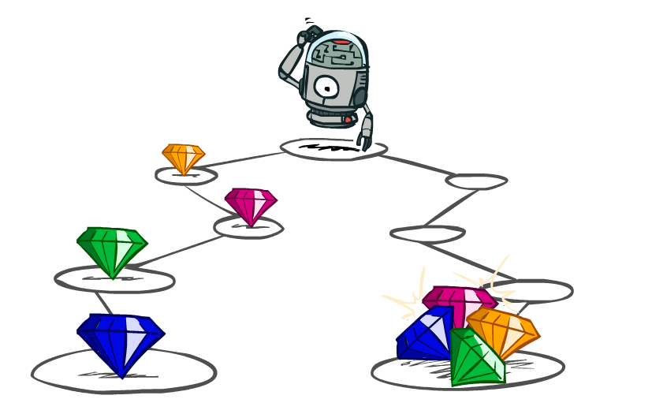
Utilities of Sequences
What preferences should an agent have over reward sequences?
More or less?
Now or later?
[1, 2, 2]
or
[2, 3, 4]
[0, 0, 1]
or
[1, 0, 0]
Notes:
Might think its easy – more or less; sure
But what about now or later; vote!

Slide 17

Utilities of Sequences
1. Additive Rewards
2. Discounted Rewards
A discount factor γ is a number between 0 and 1.
The discount factor describes the preference of an agent for current rewards over future rewards.
When γ is close to 0, rewards in the distant future are viewed as insignificant.
When γ is 1, discounted rewards are exactly equivalent to additive rewards,
Example: discount of 0.5
U([1,2,3]) = 1*1 + 0.5*2 + 0.25*3
U([1,2,3]) < U([3,2,1])

Slide 18


Example: Discounting
Given:
Actions: East, West, and Exit (only available in exit states a, e)
Transitions: deterministic
1. For γ = 1, what is the optimal policy?
2. For γ = 0.1, what is the optimal policy?
3. For which γ are West and East equally good when in state d?
<-
<-
<-
<-
<-
->
1γ=10 γ³

Slide 19
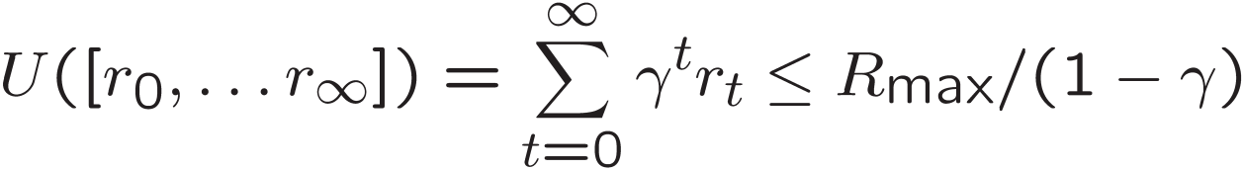
Infinite Utilities?!
Problem: What if the game lasts forever? Do we get infinite rewards?
Solutions:
Finite horizon: (similar to depth-limited search)
Terminate episodes after a fixed T steps (e.g. life)
Gives nonstationary policies (π depends on time left)
Discounting: use 0 < γ < 1
Smaller γ means smaller “horizon” – shorter term focus
If the environment contains terminal states and if the agent is guaranteed to get to one
eventually, then we will never need to compare infinite sequences.
A policy that is guaranteed to reach a terminal state is called a proper policy.

Slide 20
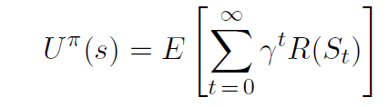
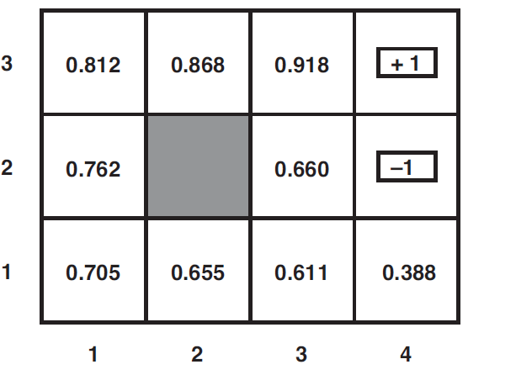
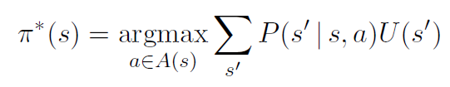
Optimal utilities and policies
The expected utility obtained by executing π starting in s is given by:
The optimal policy maximizes the expected utility.
U(s) and R(s) are quite different quantities
R(s) is the “short term” reward for being in s.
U(s) is the “long term” total reward from s onward.
γ=1, R=-0.04

Slide 21
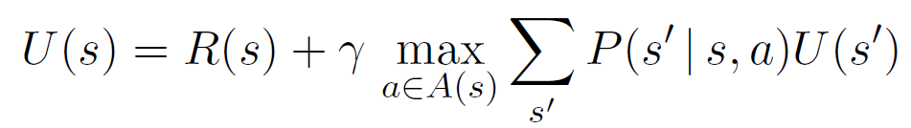
Bellman Equation
The utility of a state is the immediate reward for that state plus the expected discounted utility of the next state, assuming that the agent chooses the optimal action.
Bellman Equation:

Slide 22
Bellman Equation
For n possible states, there are n Bellman equations, one for each state.
The n equations contain n unknowns—the utilities of the states.
So we would like to solve these simultaneous equations to find the utilities.
However, the equations are nonlinear, because the “max” operator is not a linear operator.
Whereas systems of linear equations can be solved quickly using linear algebra techniques, systems of nonlinear equations are more problematic.
One thing to try is an iterative approach.

Slide 23

Value Iteration
1. Start with arbitrary initial values for the utilities,
2. Calculate the right-hand side of the Bellman equation, and plug it into the left-hand side—thereby updating the utility of each state from the utilities of its neighbors.
3. We repeat this until we reach an equilibrium. (Convergence)
Let Ui(s) be the utility value for state s at the i^{th} iteration.
The iteration step, called a Bellman update, looks like this:

Slide 24
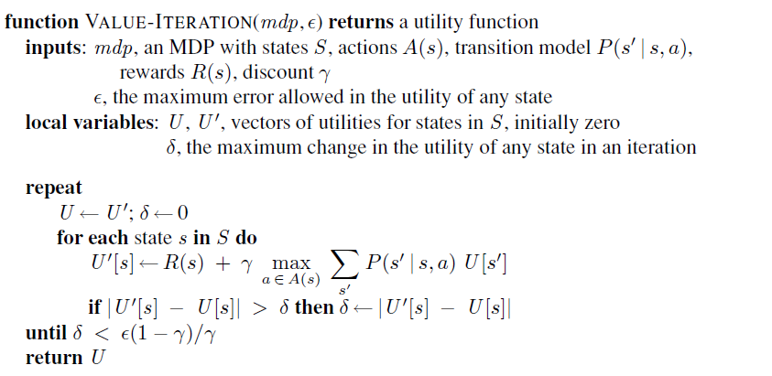
Value Iteration Algorithm

Slide 25
Value Iteration
If we apply the Bellman update infinitely often, the utilities will eventually converge.
In fact, they are also the unique solutions to the Bellman equations, and the corresponding policy is optimal.
Key note:
Policy may converge long before values do

Slide 26
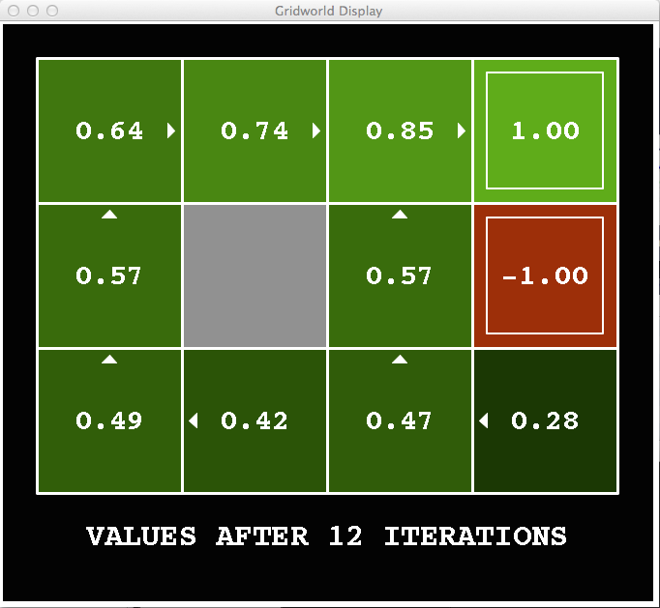
k=12
Noise = 0.2
Discount = 0.9
Living reward = 0
Notes:
Assuming zero living reward

Slide 27

k=100
Noise = 0.2
Discount = 0.9
Living reward = 0
Notes:
Assuming zero living reward

Slide 28
Policy Iteration
If one action is clearly better than all others, then the exact magnitude of the utilities on the states involved need not be precise.
Thus, we can directly find the optimal policies.
The policy iteration algorithm alternates the following two steps, beginning from some initial policy π0:
1. Policy evaluation: given a policy πi, calculate Ui =U^{πi} , the utility of each state if πi were to be executed.
2. Policy improvement: Calculate a new MEU policy πi+1, using one-step look-ahead based on Ui.
The algorithm terminates when the policy improvement step yields no change in the utilities.

Slide 29

Policy Evaluation
At the i^{th} iteration, the policy πi specifies the action πi(s) in state s.
This means that we have a simplified version of the Bellman equation relating the utility of s (under πi) to the utilities of its neighbors:
These equations are linear, because the “max” operator has been removed.
For n states, we have n linear equations with n unknowns, which can be solved
exactly in time O(n³) by the standard linear algebra methods.

Slide 30

Policy Improvement
Calculate the updated policy $πi+1$ using the evaluated utility values from the policy evaluation step $Uπi$:
$πi+1\left(s\right)=\underset{a∈A(s)}{argmax}{\sum_{s′}{P\left(s^{′} | s,a\right)Uπi(s^{′})}}$

Slide 31
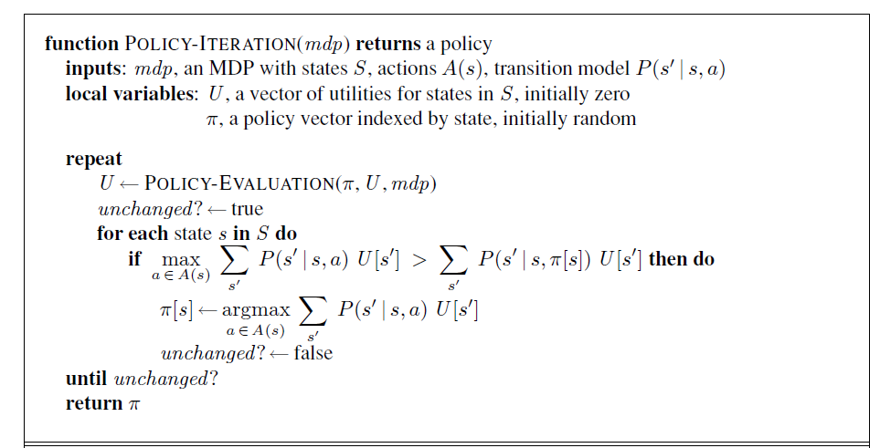
Policy Iteration Algorithm

Slide 32
Value Iteration versus Policy Iteration
Both value iteration and policy iteration compute the same thing (all optimal values)
In value iteration:
Every iteration updates both the values and (implicitly) the policy
We don’t track the policy, but taking the max over actions implicitly recomputes it
In policy iteration:
We do several passes that update utilities with fixed policy (each pass is fast because we consider only one action, not all of them)
After the policy is evaluated, a new policy is chosen (slow like a value iteration pass)
The new policy will be better (or we’re done)

Slide 33
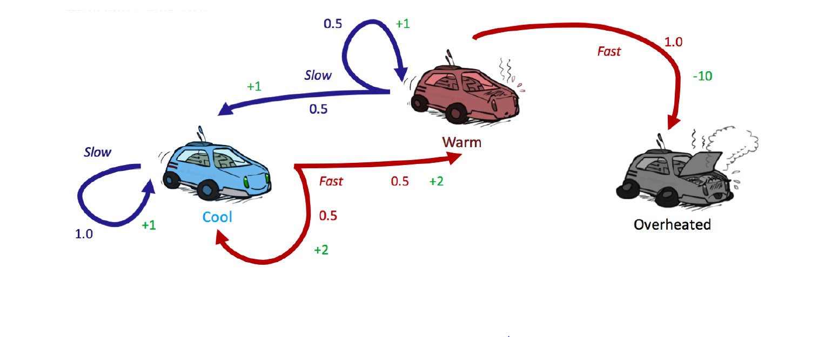
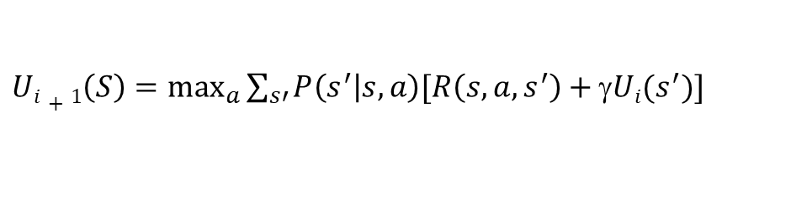
Race Car Example
States={cool, warm, overheated}
Actions={fast, slow}
γ=0.5
Initially:
U0(cool)=0
U0(warm)=0
U0(overheated=0)
Run two iterations of the value iteration algorithm.
$Ui+1\left(S\right)=\max_{a}{\sum_{s′}{P\left(s^{′} | s,a\right)[R\left(s,a,s^{′}\right)+\text{}Ui(s^{′})]}}$

Slide 34
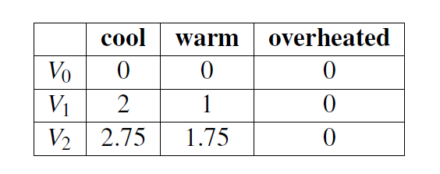
Race Car Example

Slide 35
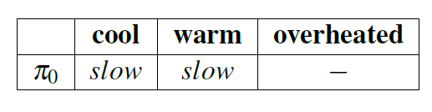
Race Car Example
Apply policy evaluation for the given initial policy:

Slide 36
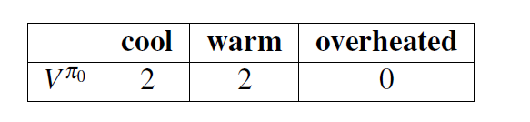
Race Car Example
Policy Evaluation:

Slide 37
Race Car Example
Apply policy iteration given the initial policy

Slide 38
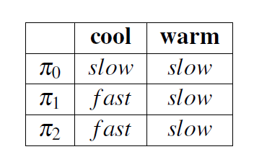

Slide 39
Sections 17.1-17.3 from the textbook.

